Slide 1
NLP Capstone Project

Slide 2
Agenda
Preprocessing
CNN vs RNN vs Transformer Discussion
Transformer Models
Approach
Results
Analysis

Slide 3
Preprocessing

Slide 4
Preprocessing: Squad dataset
Read in json files
Combine dataframes
Create a dataframe that contains each question as a row
Remove ones without answers

Slide 5
Preprocessing: Context
Problem: Giving the answer as context does not show that the transformer is extracting information
Solution: Take Wikipedia articles for context
Identify topics from preprocessed topic section
Find corresponding Wikipedia pages
Webscrape and convert Wikipedia pages to a list of strings
Clean strings

Slide 6
CNN vs rnn vs Transformer

Slide 7
Cnn vs rnn vs transformer
CNN
Pros
Identifies Prominent Topics
Cons
Not useful for answering questions
No memory
RNN
Pros
Not Computationally expensive
Cons
Generates based off of previous entries without considering context
Memory fades
Transformers
Pros
Most accurate answers
Cons
Computationally Intensive

Slide 8
Transformer Models
lmqg/t5-small-squad-qag
anas-awadalla/gpt-2-large-squad
deepset/bert-base-cased-squad2
distilbert-base-cased-distilled-squad
bert-base-cased

Slide 9
Approach

Slide 10
Approach
Initially 5 Transformers
Just using Bert variants
Run the same questions and answers from the SQUAD Dataset
Compare their cosine similarities to the actual answer

Slide 11
Results

Slide 12
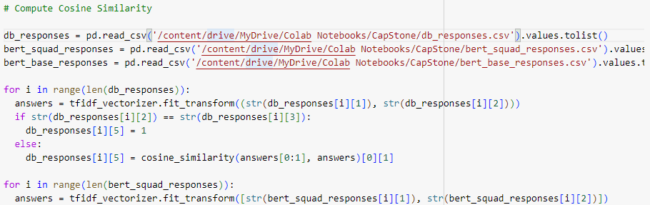
Results
Once answers were generated, Cosine similarities were computed to determine accuracy.

Slide 13
Average cosine similarities

Slide 14
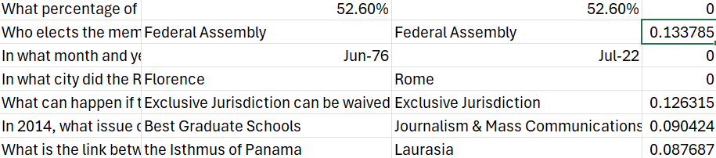
Errors
Exact matches return cosine similarity that isn’t one
Cosine Similarity seems to be off

Slide 15
Analysis

Slide 16
Analysis
Trained vs. Untrained
Bert based models
GPT models
T5
Transformer | Cosine Similarity | Speed
Deepset/bert-base-cased-squad2 | 0.2516087 | Fast
Distilbert-base-case-distilled-squad | 0.2516087 | Fastest
Bert-base-cased | 0.0516087 | Slowest
Lmqg/t5-small-squad-qag | NA | Slow
Anas-awadalla/gpt-2-large-squad | NA | Too Slow

Slide 17
Final tips & takeaways
Transformers
Distilbert
RNN
Fast but not as accurate
CNN
Not appropriate for q&a
Topic Identification
Cosine Similarity

Slide 18
Thank you

Slide 19
Works CIted
awadalla, anas. “Gpt-2-Small-Squad.” Huggingface.co, 2024, huggingface.co/anas-awadalla/gpt-2-small-squad.
This source was used for the GPT2 model in the question answering portion of this project.
deepset. “Deepset/Bert-Base-Cased-Squad2 · Hugging Face.” Huggingface.co, 4 Jan. 2024, huggingface.co/deepset/bert-base-cased-squad2.
This source was used for the Deepset Bert model which was used as one of the models for the question answering portion of this project.
Devlin, Jacob, et al. “{BERT:} Pre-Training of Deep Bidirectional Transformers for Language Understanding.” Huggingface.co, 18 Jan. 2024, huggingface.co/google-bert/bert-base-uncased.
This source was used for the Bert model which was used as one of the models for the question answering portion of this project.
Janiszewski, Bogdan. “Removing Index Column in Pandas When Reading a Csv.” Stack Overflow, 20 Nov. 2013, stackoverflow.com/questions/20107570/removing-index-column-in-pandas-when-reading-a-csv.
This source was used to see how to write and read pandas csvs without an index column.

Slide 20
Works CIted
ogrisel. “Machine Learning - Python: Tf-Idf-Cosine: To Find Document Similarity.” Stack Overflow, 26 Aug. 2012, stackoverflow.com/questions/12118720/python-tf-idf-cosine-to-find-document-similarity.
This source was used to determine the cosine similarities between the generated and actual answers.
pratikchakra18. “Different Methods to Find Document Similarity.” GeeksforGeeks, 16 Aug. 2024, www.geeksforgeeks.org/different-methods-to-find-document-similarity/.
This source was used to determine the cosine similarities between the generated and actual answers.
rakshitarora. “Wikipedia Module in Python.” GeeksforGeeks, 5 Mar. 2020, www.geeksforgeeks.org/wikipedia-module-in-python/.
This source was used to gather context for the questions from Wikipedia.
Sanh, Victor, et al. “DistilBERT, a Distilled Version of BERT: Smaller, Faster, Cheaper and Lighter.” Huggingface.co, 4 Mar. 2024, huggingface.co/distilbert/distilbert-base-cased-distilled-squad.
This source was used for the DistilBERT model which was used as one of the models for the question answering portion of this project.
Ushio, Asahi, et al. “‘{G}Enerative {L}Anguage {M}Odels for {P}Aragraph-{L}Evel {Q}Uestion {G}Eneration.’” Huggingface.co, 18 Dec. 2022, huggingface.co/lmqg/t5-small-squad-qag.
This source was used for the T5 model which was used as one of the models for the question answering portion of this project.

Slide 21
Acknowledgement of Assistance
ChatGPT. Assistance given to the author, AI. I used the following prompts in ChatGPT: “remove two characters after % regular expression,” “im webscraping wikipedia pages, but one of my items is being inputed wrong below is my code pages = [] i = 0 for topic in wikiTopics: print(topic.lower()) pages.append(wikipedia.page(str(topic).lower())) i+=1,” “its running into an error where it says Wikipedia Page objects have no len(),” “condense list of strings to string,” “how do i save a string as a text file,” “how to i read in a text file as a string,” “how do i write each entry in a list as a seperate line,” “and then how do i read in the lines,” and “How to train bert model using transformers pipeline for question answering.” Chat GPT then responded with the respective code for each of these requests. Code used from these responses are marked Chat in the Jupyter notebook files. Additionally, the training segment was not used since I ended up finding pretrained models online. OpenAI, (https://chatgpt.com/share/67631a8e-19a8-8005-b52d-fe8c5a9a6289). West Point, NY, 16-18DEC2024.

